Slide 1
Figure Drawing
Stick figures, skeletons, and beyond

Slide 2
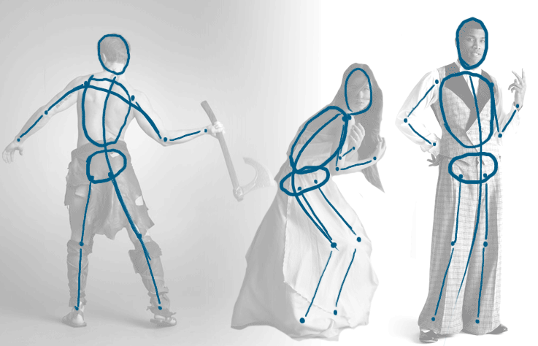
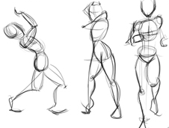
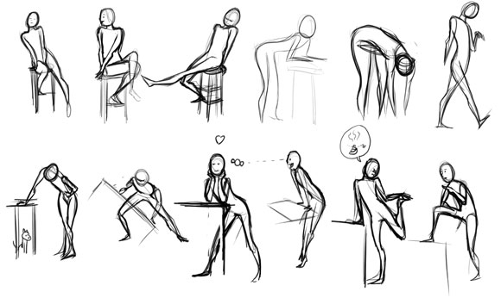
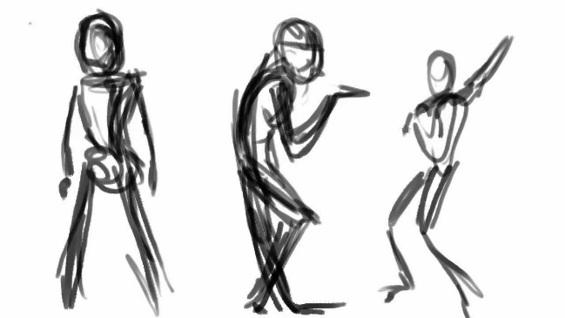
Gesture Drawings
A gesture drawing is a very quick sketch that artists often use as a warm-up. The goal of a gesture is to capture the general shape and movement of the subject, without getting bogged down in the details.

Slide 3
Proportion
The human body has some very predictable measurements that will help you make a body look realistic. Skeletal anatomy and some handy rules of thumb can guide you in your drawings!
Let’s learn more
Notes:
In Slide Show mode, click the arrow to enter the PowerPoint Getting Started Center.

Slide 4
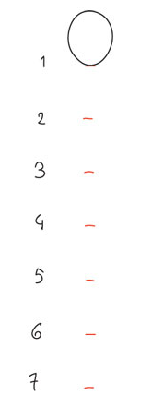
An adult human is ~7 to 8 heads tall
Let’s learn more
Notes:
In Slide Show mode, click the arrow to enter the PowerPoint Getting Started Center.

Slide 5
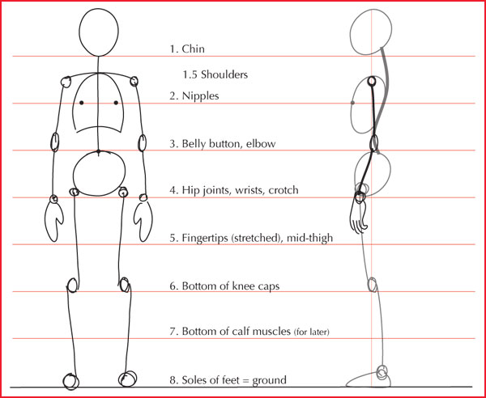
Notes:
In Slide Show mode, click the arrow to enter the PowerPoint Getting Started Center.

Slide 6
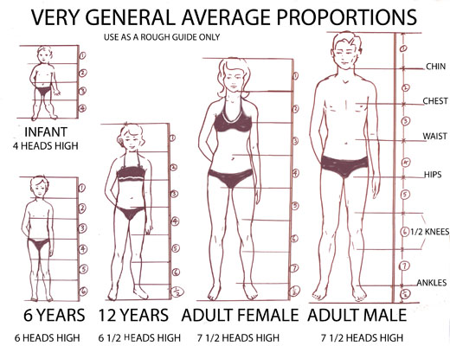
Children have bigger heads compared to total height, the younger they are.
Let’s learn more
Notes:
In Slide Show mode, click the arrow to enter the PowerPoint Getting Started Center.

Slide 7
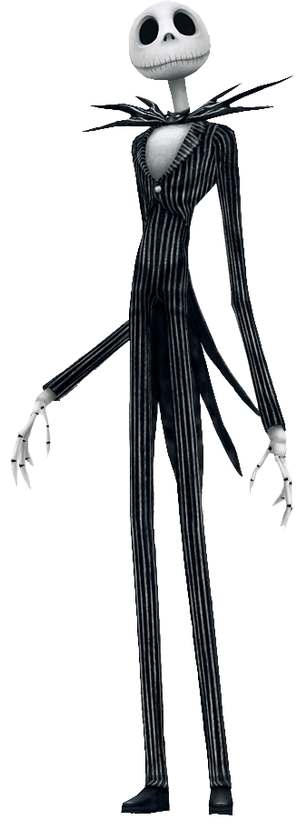
Skeletal Anatomy
sp00ky
Let’s learn more
Notes:
In Slide Show mode, click the arrow to enter the PowerPoint Getting Started Center.

Slide 8
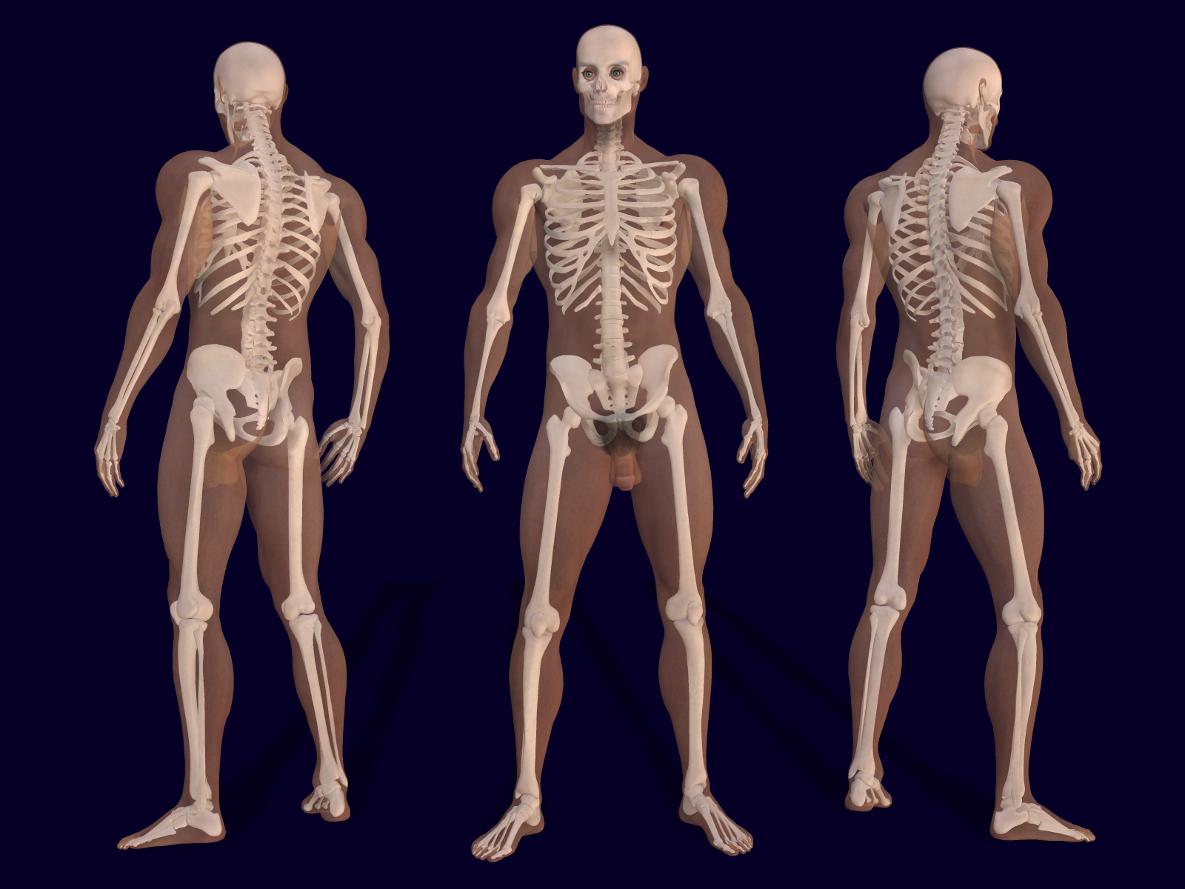
The Basic Skeleton
Basic parts of the skeleton:
-Skull
-Spine
-Shoulder blades and ribs
-Pelvic bone
-Arms and Hands
-Legs and Feet

Slide 9
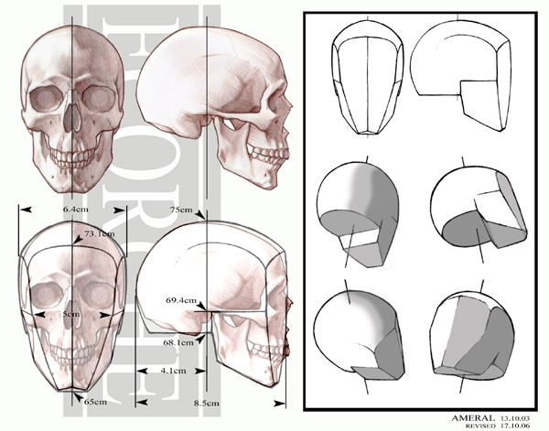
The Skull
Eye sockets are close to the center of the head
The mouth is halfway between the bottom of the nose and the bottom of the chin
The whole head looks like a squashed sphere with a prism shape for the chin

Slide 10
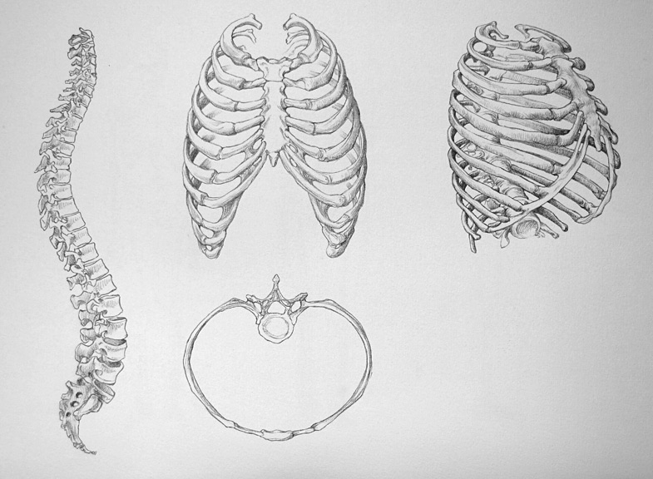
Spine and Ribs
The spine is S-shaped from the side!
Ribs define the shape of the torso. Figuring out the ribs’ 3D shape will help you create volume in drawings.

Slide 11
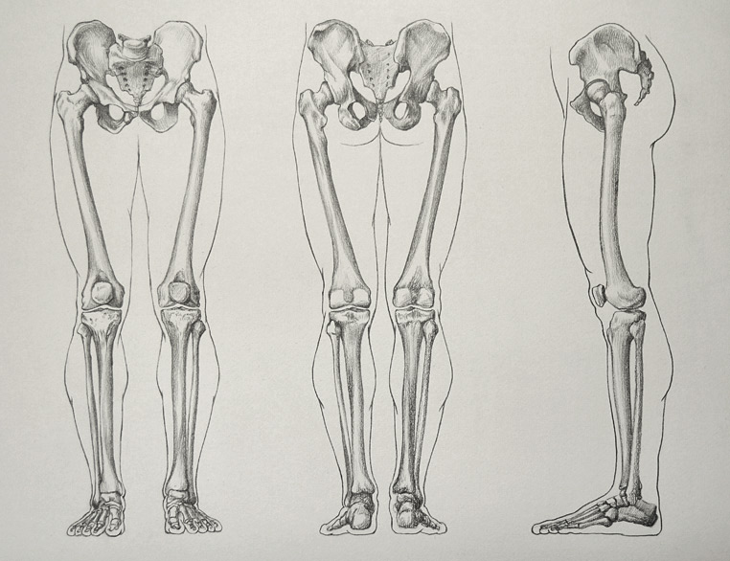
Pelvis / Legs
What do you observe about how the leg bones fit into the body?
How are the upper (femur) and lower (tibia/fibula) leg bones different?
How would you use these bones as a guide to draw the outline of the legs?

Slide 12
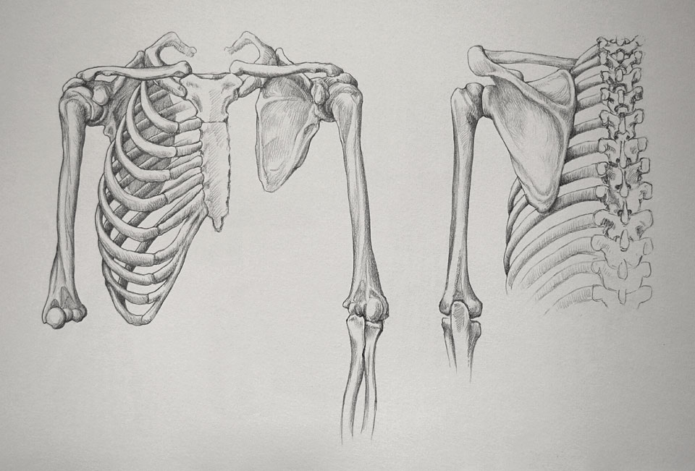
Shoulders / Arms
How does the arm connect to the shoulder?
What’s the difference between the shoulder joint and the elbow joint?
Do you notice any similarities in the bones of the arms vs. legs?

Slide 13
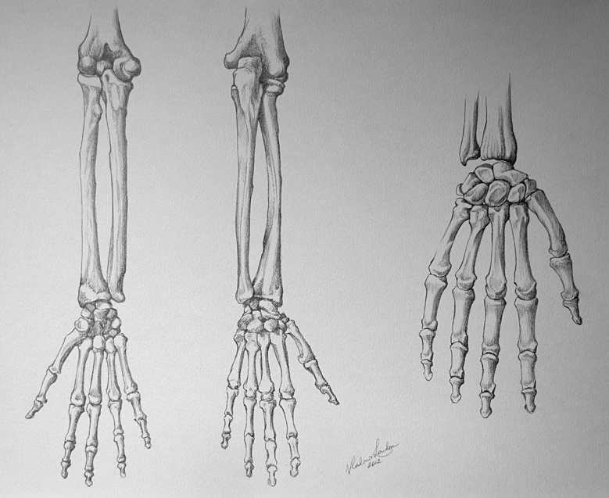
Hands
Hands can intimidate even some of the most accomplished artists!
Use your knowledge of the different sections of the hand to map out different hand positions.

Slide 14
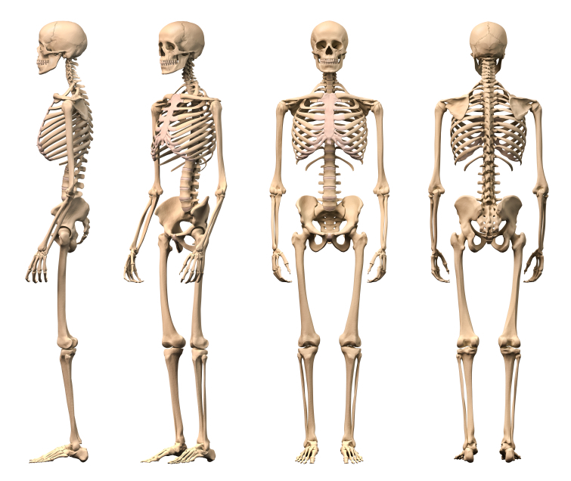
Drawing Practice!

